Slide 1
Tissue development: from transcription to signaling pathways
Peng He
California Institute of Technology
Hinxton, 9/20/2018
Notes:
coordinated

Slide 2
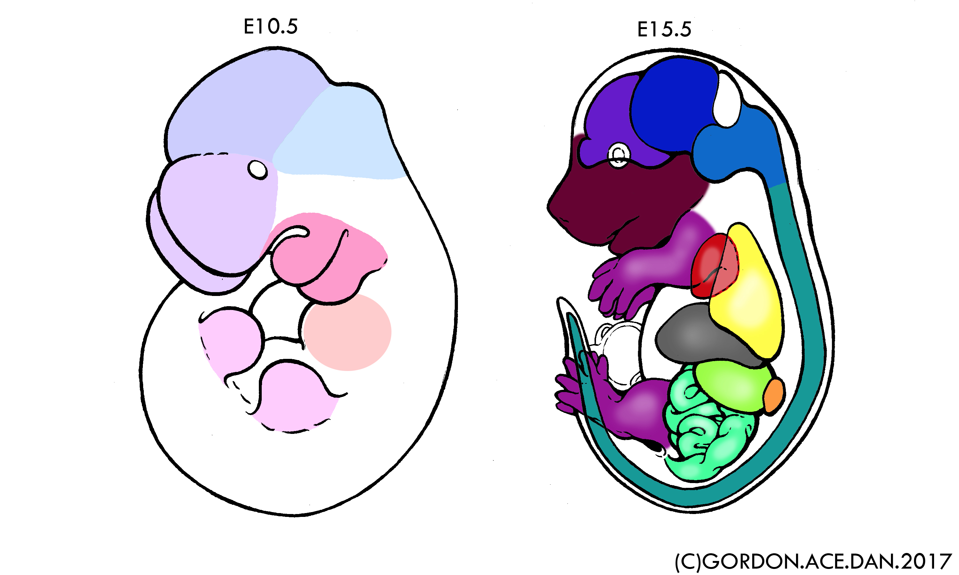
Differential genes and cellular contribution
?
Three mechanistic components
Cytodifferentiation
Cell migration
Differential
Proliferation/death

Slide 3
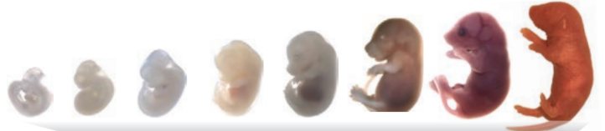
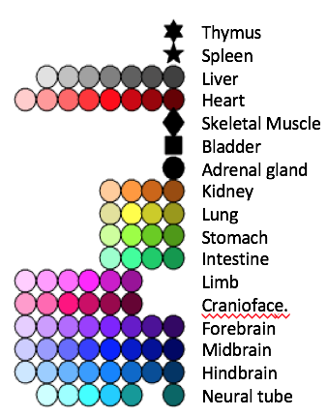
Bulk comparison reveals gene expression modules with distinct tissue specificity and temporal trends
Muscle
Keratin
Bladder
Contractile
Hormone
Thymus immune
E10.5 E11.5 E12.5 E13.5 E14.5 E15.5 E16.5 P0
Transport & apical
Inflammatory & exosome
Immunoglobin
Immune
Brush border
NA
Lung
Cornified
Technical A
ECM
Eye & melanin
Technical B
Hox9-13
Wnt
Cell cycle
Technical C
Technical D
Lipid
Hox1-9
Neurohypophyseal
Cilium
Mesonephros
Thymus
Metal ion transport
Neuron fate
Adenylate cyclase
Cell projection
Gene
Synapse
e14.5
P0
e12.5
e16.5
e11.5
e13.5
e15.5
e10.5
Tissue/Time

Slide 4
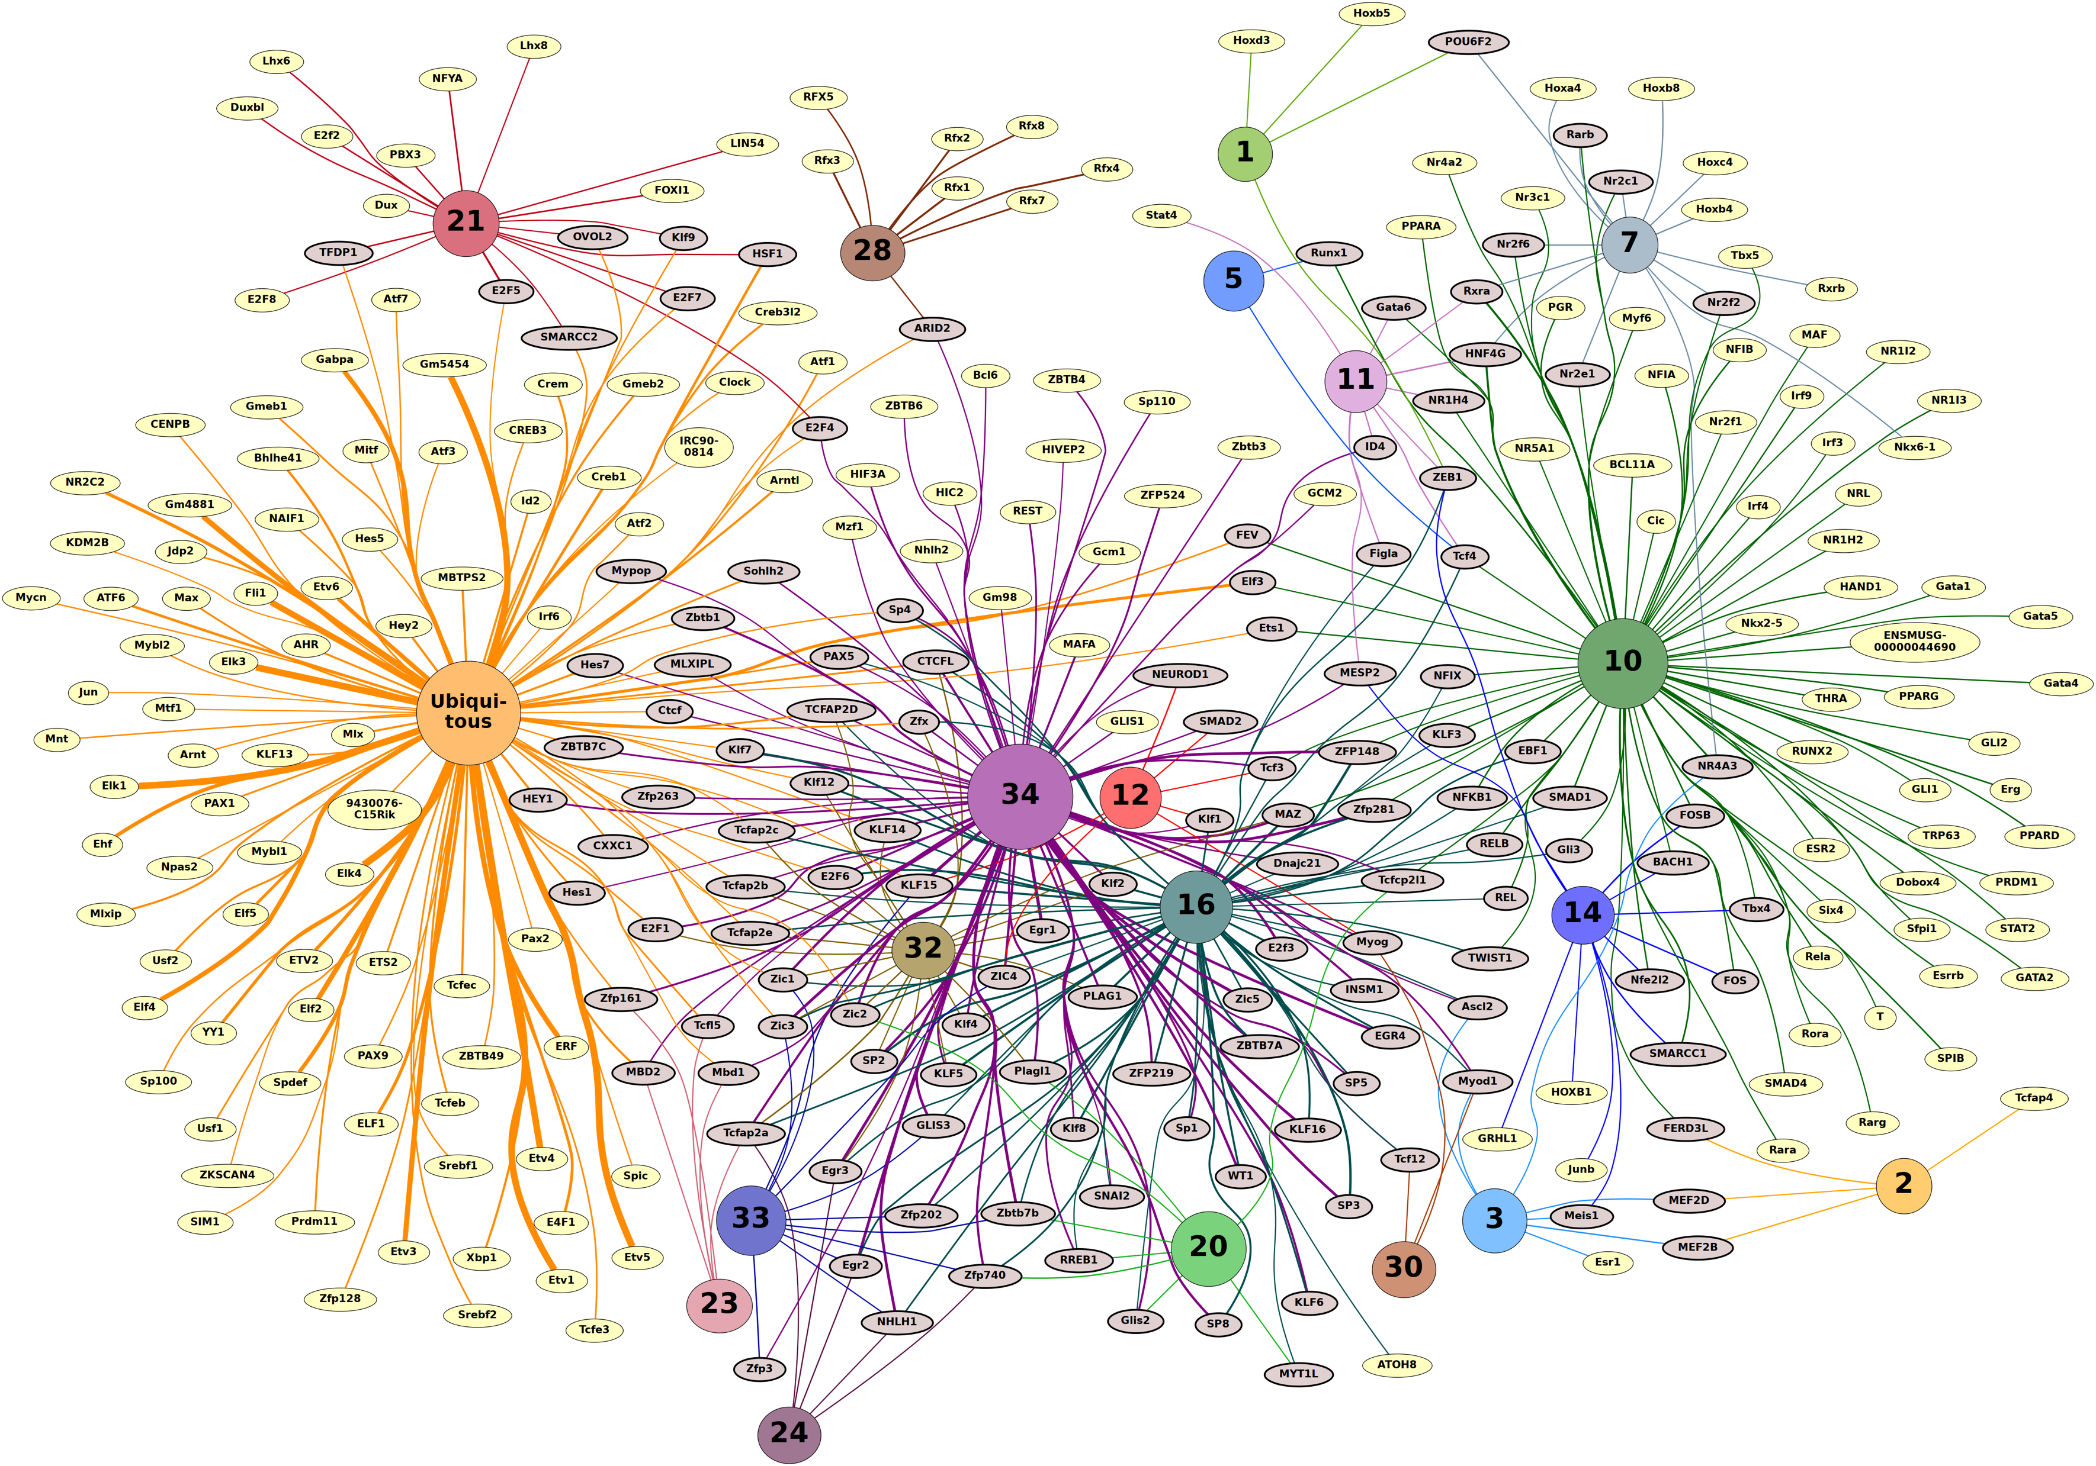

Slide 5
Promoter motif analyses predict specific and shared upstream regulators

Slide 6
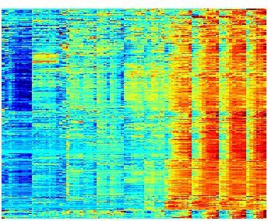
Individual clusters, individual mechanisms
T | S | Lvr | Hrt | M | B | A | Kdn | Lng | Stm | Int | Lmb | Fac | Fb | Mb | Hb | Nt
Notes:
Individual clusters -> individual mechanisms
When we look at the promoters, a striking pattern emerged

Slide 7
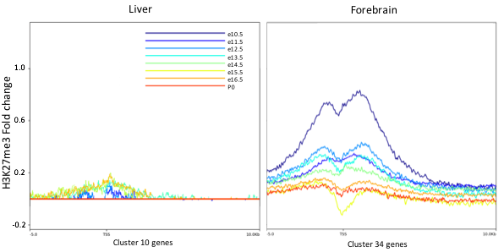
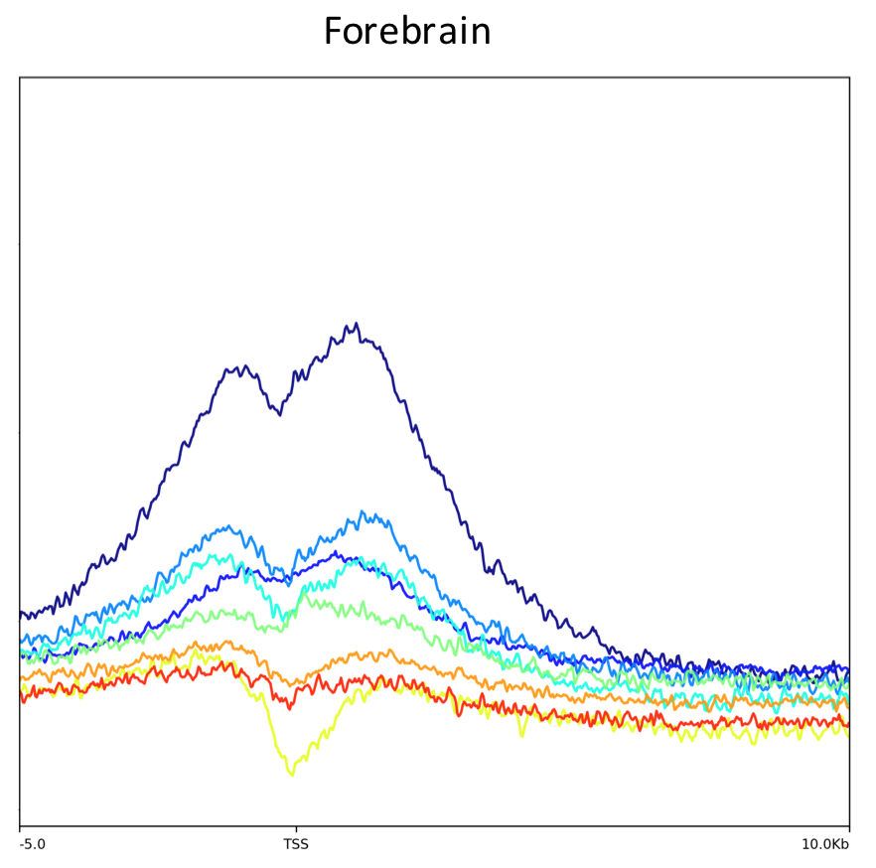
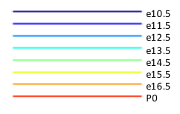
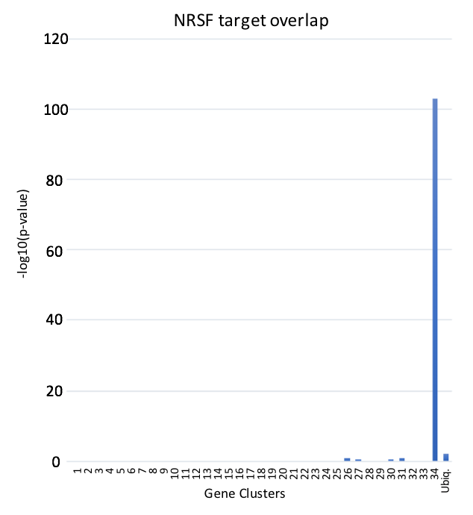
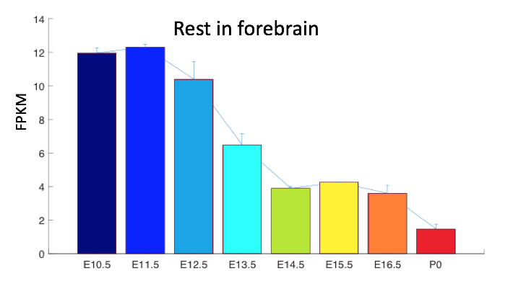
Neuronal-specific repression mediated by Rest
H3K27me3 fold enrichment
TSS
Rest target overlap
H3K27me3
Rest
CNS
Genes
Time
Notes:
HIPP1 is a regulator of Rest
keep it on a drive
keep a pdf copy
a web version

Slide 8
Differential genes and cellular contribution
?
Three mechanistic components
Cytodifferentiation
Cell migration
Differential
Proliferation/death
Notes:
bulk -> clusters -> what genes are there

Slide 9
Deconvolving gene expression patterns during limb development at single-cell level
Notes:
classicmodel
easy to dissect

Slide 10
Continuous development made of at least 12 discrete states
Cell fraction
Muscle 3
Muscle 1
Muscle 2
Mesenchyme1
Endothelial
tsne1
Macrophage
EMP
Epithelial
Time
Mesenchyme2
Neural Crest
Perichondrium
Chondrocyte
tsne1
920 cells

Slide 11
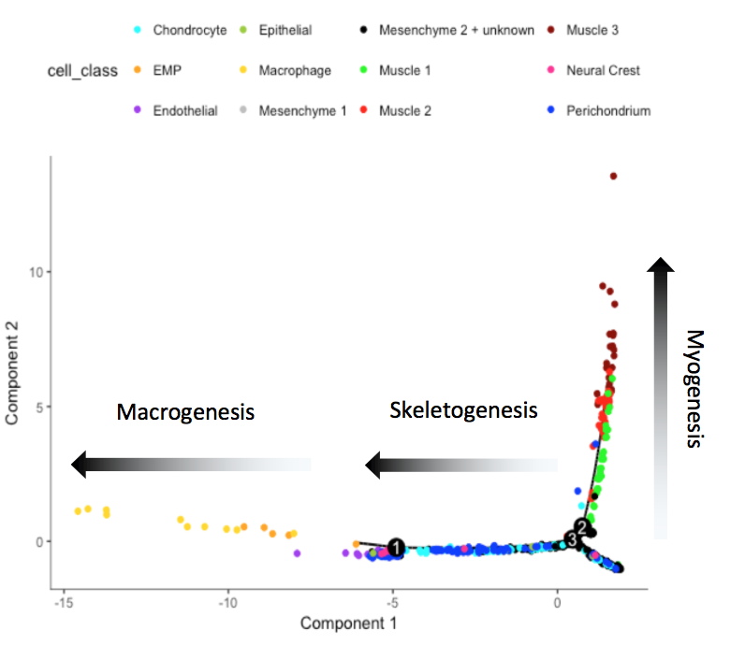
3 major lineages revealed
Macrophage genesis
Notes:
mention "Monocle by Trapnell lab" at the bottom

Slide 12
Limb lineage progression recapitulate the three components of differential expression
Pdgfra+
Myod1+ Pax3+
Gata1+
Cytodifferentiation
Myod1+ Pax3+
Pdgfra+
Gata1+
Cell immigration
Myod1+ Pax7+
Col2a1+
Pdgfra+
Col1a1+
Pdgfra+
Differential
C1qa+
Proliferation/death
Myod1+ Myog+
limb

Slide 13
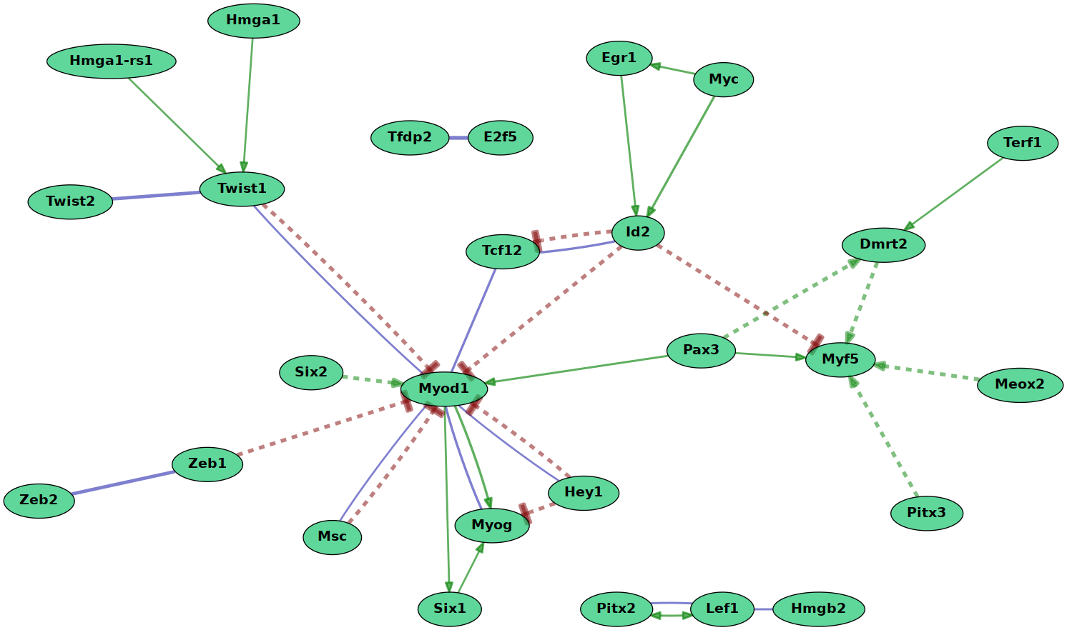
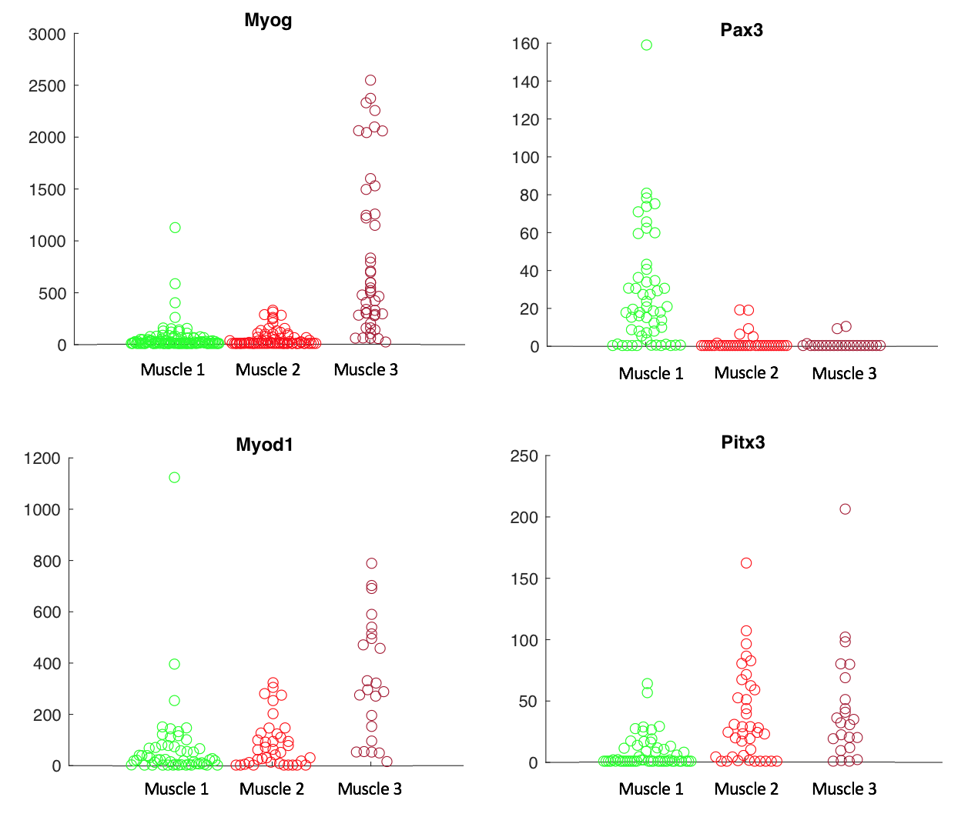
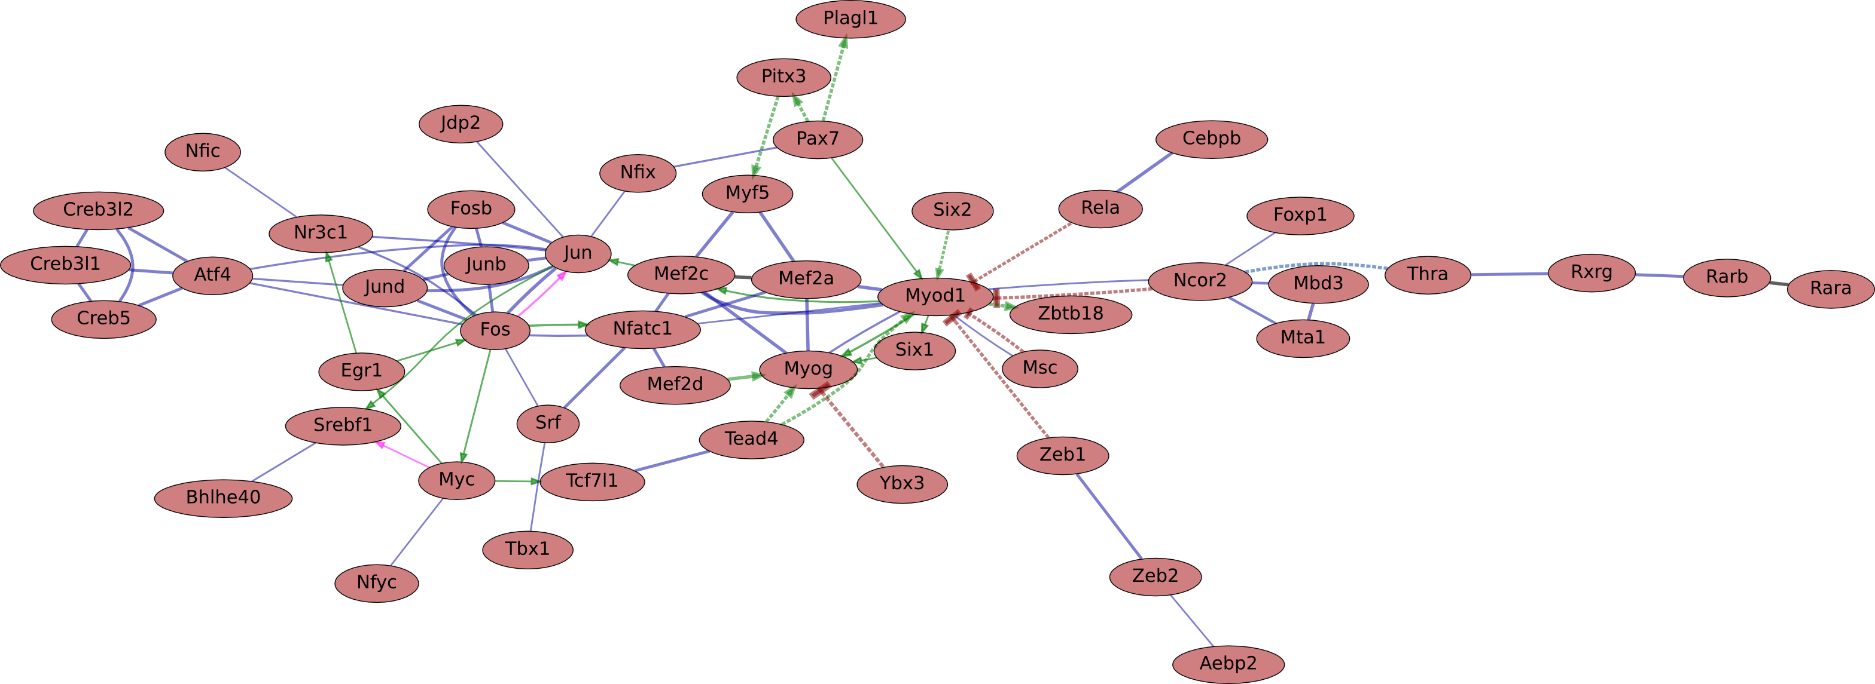
Pan-lineage and stage-specific transcription factors contribute to regulatory network
Differentiation
Differentiation

Slide 14
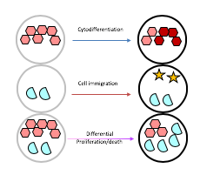

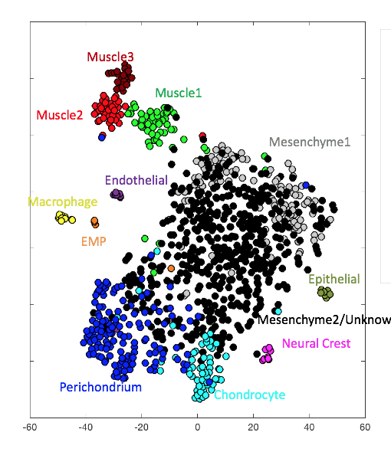
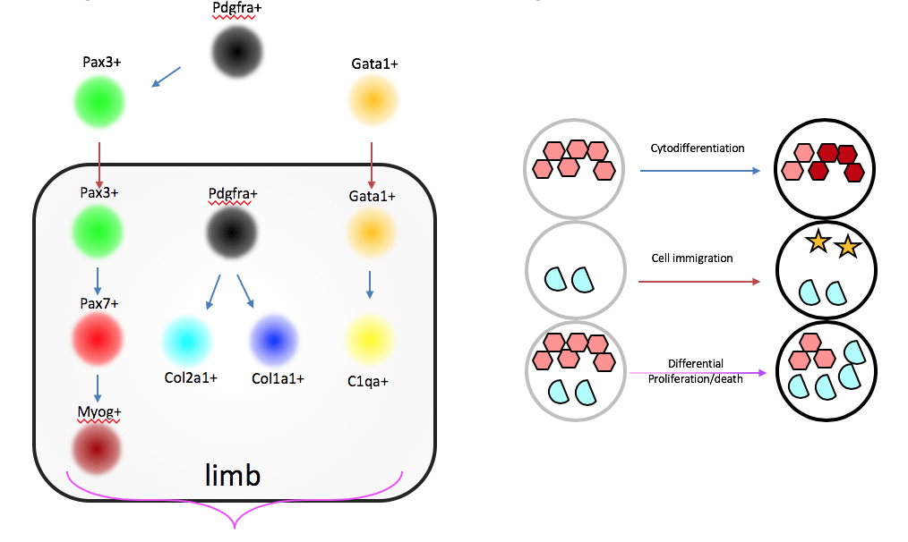
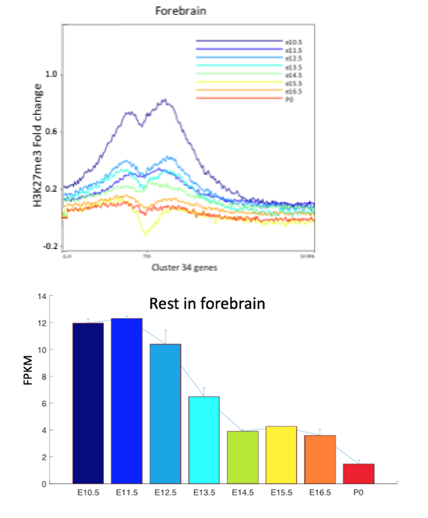
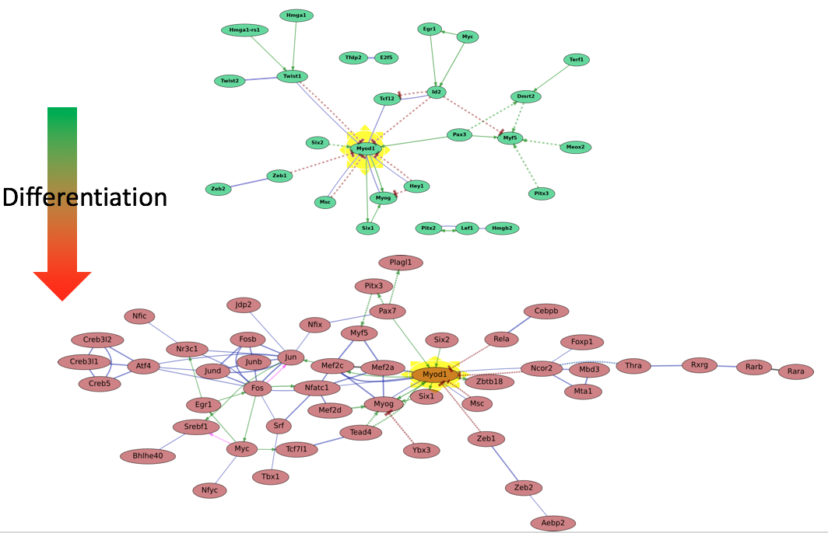
Summary
Dissociate
Deconvolute cell types
Bulk transcriptome comparison
Global transcription regulation
Cell state-specific regulatory network

Slide 15
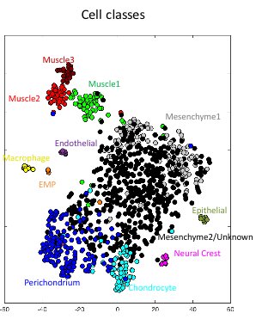
10% of Cell type-specific markers are known ligands or receptors
coordination
Notes:
intra and inter cell interactions

Slide 16
From transcription network to signaling network
Single-cell transcriptome reference
Sarah Teichmann and Evangelia Petsalaki
Aim 1: Cell-specific signaling networks
Aim 1
Aim 2
Aim 2: Spatial pattern of differentially regulated signaling and gene regulatory networks
Mimeault and Batra 2010
Grandel et al 2011
Interactome knowledge
Spatial information
Aim 3
Aim 3: Inference of spatially-dependent interplay of signaling and gene regulatory networks
Ramilowski et al 2015
Notes:
HGF and c-Met involved in detachment of myogenic precursor cells from the lateral dermomyotomes and their subsequent migration into the newly formed limb buds.
apical ectodermal ridge

Slide 17
Acknowledgement
Brian Williams
Georgi Marinov
Diane Trout
Henry Amrhein
Barbara Wold*
ENCODE mouse group
Axel Visel
Len Pennacchio
Bing Ren
Yu Zhang

Slide 18
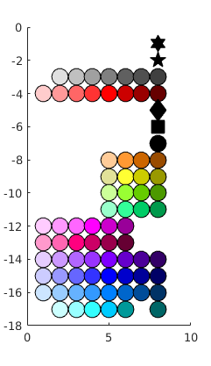
Transcriptomes: domains and trajectories
Thymus
Spleen
Liver
Heart
Skeletal Muscle
Bladder
Adrenal gland
Kidney
Lung
Stomach
Intestine
Limb
Cranioface.
Forebrain
Midbrain
Hindbrain
Neural tube
Notes:
**over sampled brains
**could down sample

Slide 19
Most genes increase over developmental time
Notes:
put a color legend

Slide 20
Muscle lineage: two types of transcription factor switches
FPKM
FPKM
Muscle3
Muscle2
Muscle1
Muscle3
Muscle2
Muscle1
FPKM
FPKM
Muscle3
Muscle2
Muscle1
Muscle3
Muscle2
Muscle1

Slide 21
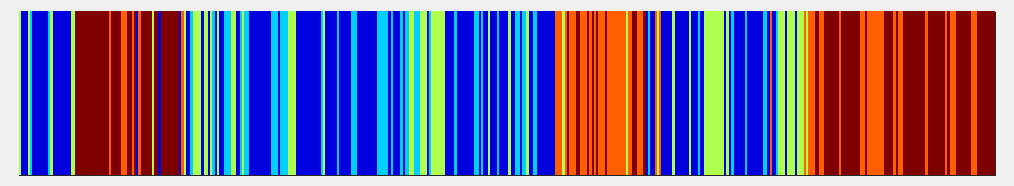
Distinct gene programs among limb Single-cells
Time

Slide 22
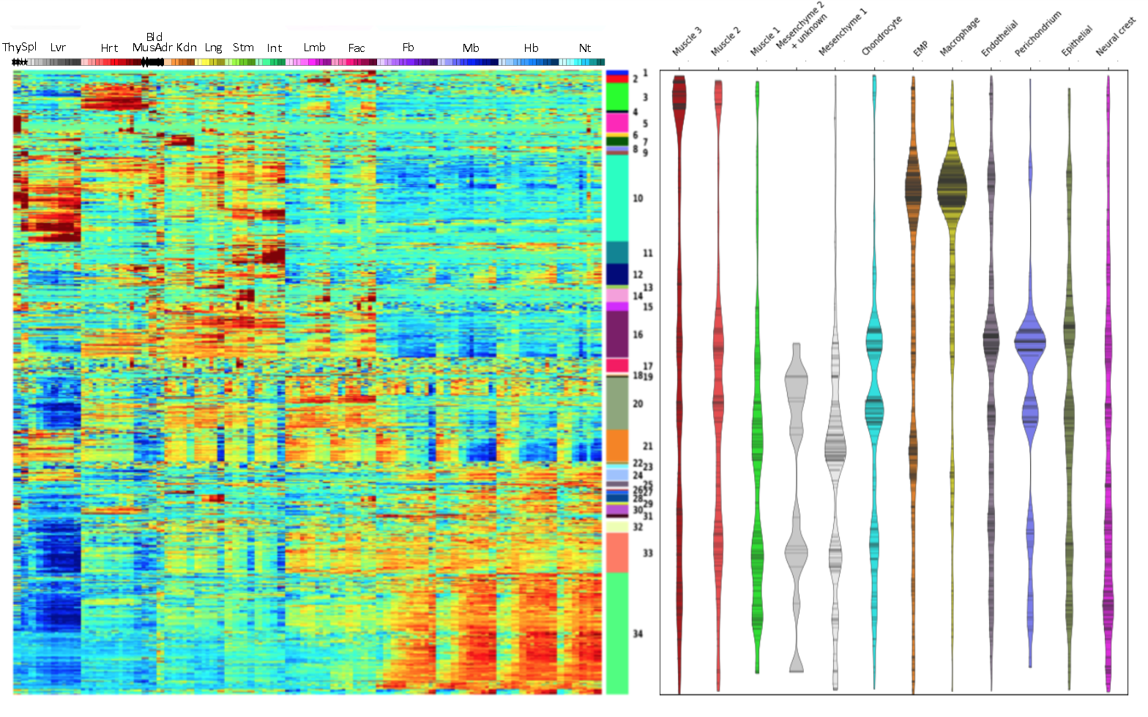
Comparing bulk and single-cell

Slide 23
10X 3’ tag confirms C1 fluidigm cell types
Mesenchyme2/Unknown
Perichondrium
Epithelial
Chondrocyte
Neural Crest
Muscle3
Muscle2
Muscle1
Epithelial
Mesenchyme1
Macrophage
Endothelial
RBC
EMP

